Slide 1
What is Kubernetes
Kubernetes (sometimes shortened to K8s with the 8 standing for the number of letters between the “K” and the “s”)

Slide 2
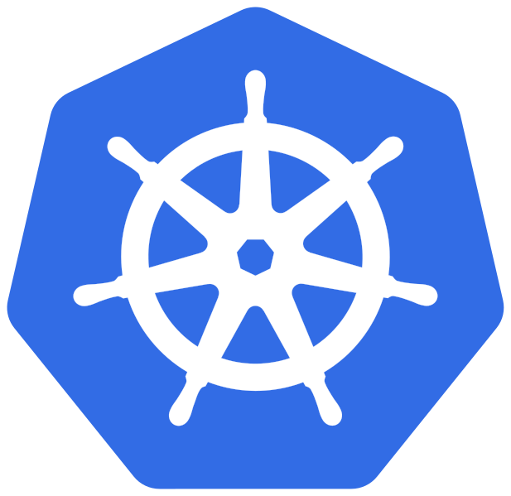
With the widespread adoption of containers among organizations, Kubernetes, the container-centric management software, has become the de facto standard to deploy and operate containerized applications. Google Cloud is the birthplace of Kubernetes—originally developed at Google and released as open source in 2014.

Slide 3
Kubernetes makes everything associated with deploying and managing your application easier. Providing automated container orchestration, Kubernetes improves your reliability and reduces the time and resources attributed to daily operations.
Kubernetes automates operational tasks of container management and includes built-in commands for deploying applications, rolling out changes to your applications, scaling your applications up and down to fit changing needs, monitoring your applications, and more—making it easier to manage applications.

Slide 4
What are the benefits of Kubernetes?
Automated operations
Kubernetes has built-in commands to handle a lot of the heavy lifting that goes into application management, allowing you to automate day-to-day operations. You can make sure applications are always running the way you intended them to run.
Infrastructure abstraction
When you install Kubernetes, it handles the compute, networking, and storage on behalf of your workloads. This allows developers to focus on applications and not worry about the underlying environment.
Service health monitoring
Kubernetes continuously runs health checks against your services, restarting containers that fail, or have stalled, and only making available services to users when it has confirmed they are running.

Slide 5
Kubernetes vs. Docker
Often misunderstood as a choice between one or the other, Kubernetes and Docker are different yet complementary technologies for running containerized applications.
Docker lets you put everything you need to run your application into a box that can be stored and opened when and where it is required. Once you start boxing up your applications, you need a way to manage them; and that's what Kubernetes does.
Kubernetes is a Greek word meaning ‘captain’ in English. Like the captain is responsible for the safe journey of the ship in the seas, Kubernetes is responsible for carrying and delivering those boxes safely to locations where they can be used.

Slide 6
Kubernetes can be used with or without Docker
Docker is not an alternative to Kubernetes, so it’s less of a “Kubernetes vs. Docker” question. It’s about using Kubernetes with Docker to containerize your applications and run them at scale
The difference between Docker and Kubernetes relates to the role each play in containerizing and running your applications
Docker is an open industry standard for packaging and distributing applications in containers
Kubernetes uses Docker to deploy, manage, and scale containerized applications

Slide 7
References
https://cloud.google.com/learn/what-is-kubernetes

